Slide 1
BME 404 –Medical Imaging Sessional Lab-5
Prepared by – Samiul Based Shuvo

Slide 2

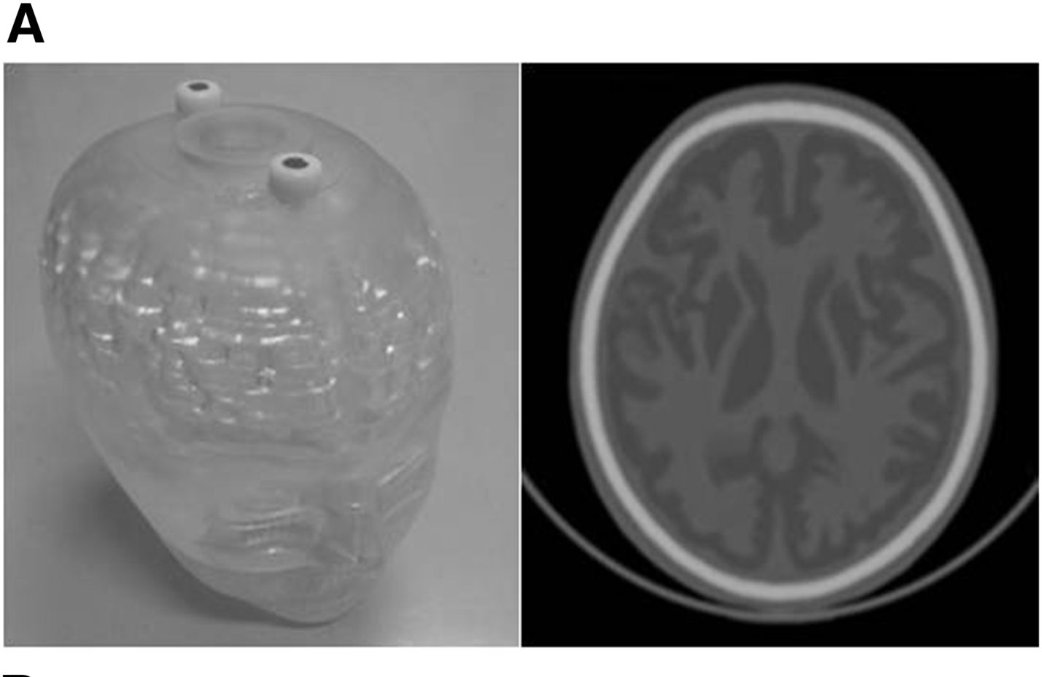
Phantom
Synthetic Phantom image
serves as the model of a human head in the development and testing of image reconstruction algorithms
The bright elliptical shell along the exterior is analogous to a skull and the many ellipses inside are analogous to brain features or tumors.
Appearance and CT image of 3D brain phantom

Slide 3
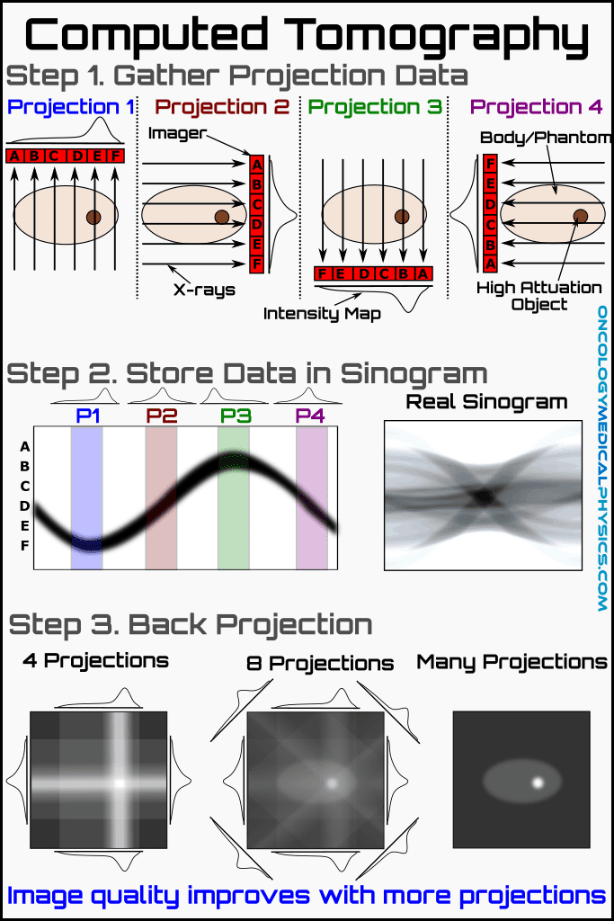

Slide 5


Slide 7
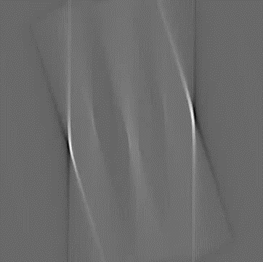

Slide 8
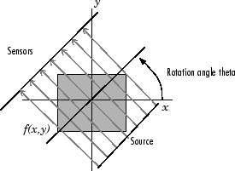

Slide 9
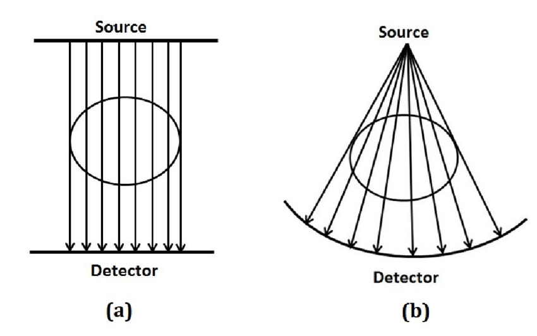
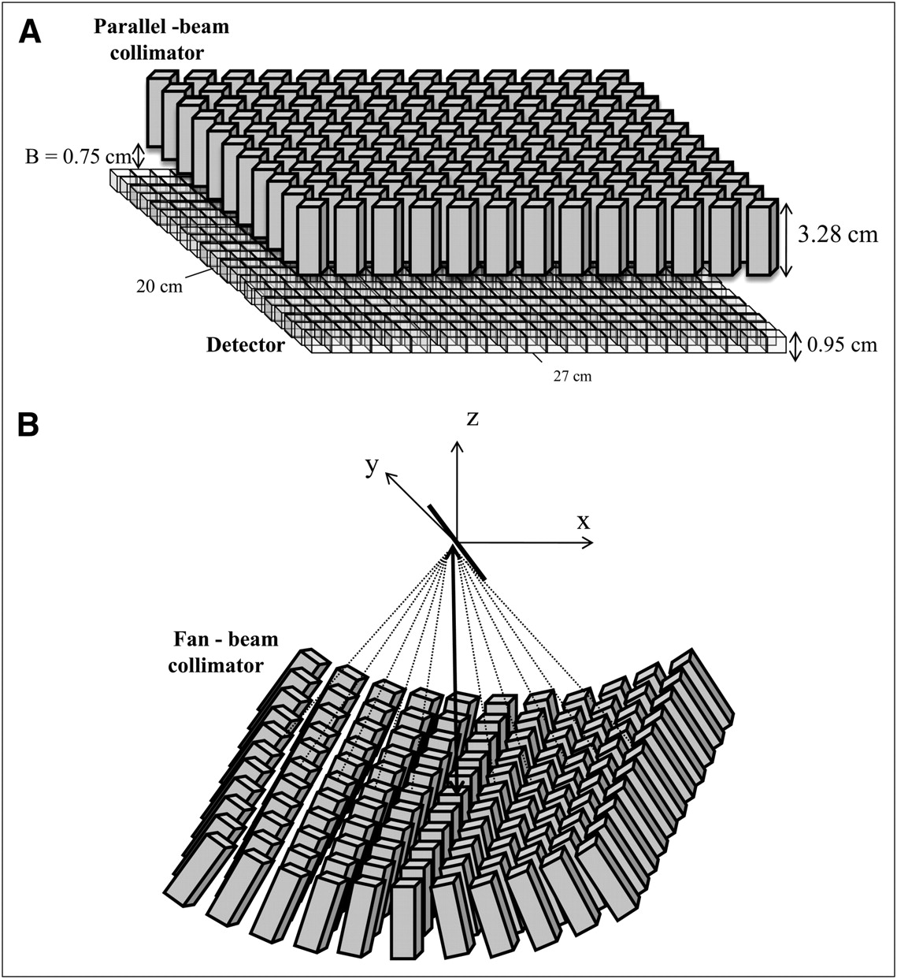

Slide 10
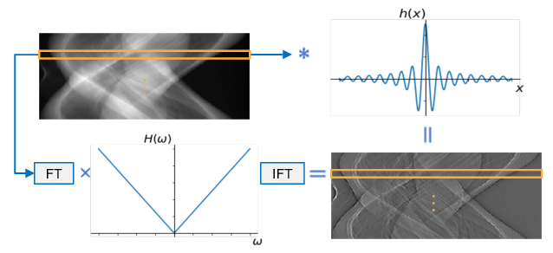
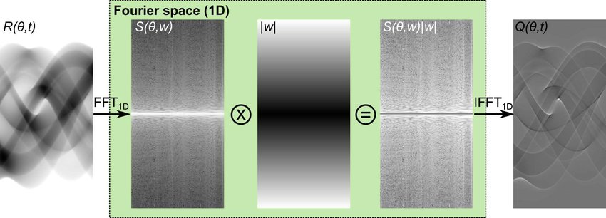

Slide 11
